Slide 1
Monthly BOE Updates…
“Building a Stronger Tomorrow…Today”
TCS Strategic Plan

Slide 2
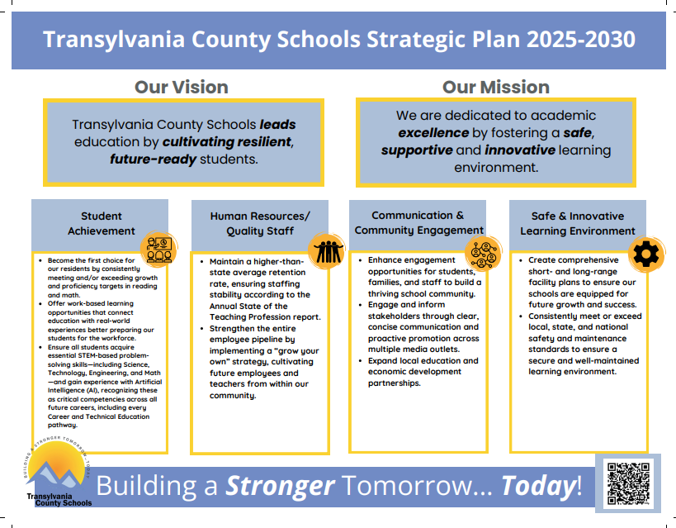

Slide 3
September District Strategic Plan Update…
Priority: | Communication and Community Engagement
Goal: | 3.1.1: Number of Community Feedback Sessions/Surveys
Measure/Progress: | Goal: 3 by June 2026; Current progress: 1 Back-to-school Survey
Notes/Comments: | https://docs.google.com/presentation/d/1G2e-DQ5KDBXDprTTqJohNQ1yQNZWzZGqyY76Ps5dODY/edit?usp=sharing

Slide 4
September District Strategic Plan Update…
Priority: | Communication and Community Engagement
Goal: | 3.1.2: Number of Community-Building Events in TCS.
Measure/Progress: | Goal 14 by June 2026; Progress: 9 (Meet the Teacher and Orientation)
Notes/Comments: | To come: Elementary Title I Parent Events (Fall)

