Slide 1
Youth Substance Use & Behavioral Health Survey
To Transylvania County Schools Board of Education
April 21, 2025

Slide 4
Youth Substance Use & Behavioral Health Survey
Substance Use Questions
Past 30-day use
Perception of harm
Peer & parent disapproval
Ease of access
AND…
Age of initiation
Past year use
Access points

Slide 5
Youth Substance Use & Behavioral Health Survey
Behavioral Health Questions
Key depression & anxiety symptoms
Number of poor mental health days
Access to care
…and Protective Factors
Presence of caring adult
Family expectations
Afterschool activities
Coping skills

Slide 6
Survey Sample Size

Slide 7
Data Limitations
Social desirability bias
Sampling bias

Slide 8
Results: Past 30-day Use, Middle School

Slide 9
Results: Past 30-day Use, High School

Slide 10
Results: Past 30-day Use, Vaping

Slide 11
Perception of Harm— Middle School
No/Slight Risk
24%
18%
28%
28%
20%

Slide 12
Perception of Harm— High School
No/Slight Risk
31%
20%
45%
30%
22%

Slide 13
Perception of Peer Disapproval— Middle School
Not at all/ a little bit
13%
8%
9%
9%
7%

Slide 14
Perception of Peer Disapproval— High School
Not at all/ a little bit
21%
13%
22%
14%
13%

Slide 15
Ease of Access: High School

Slide 16
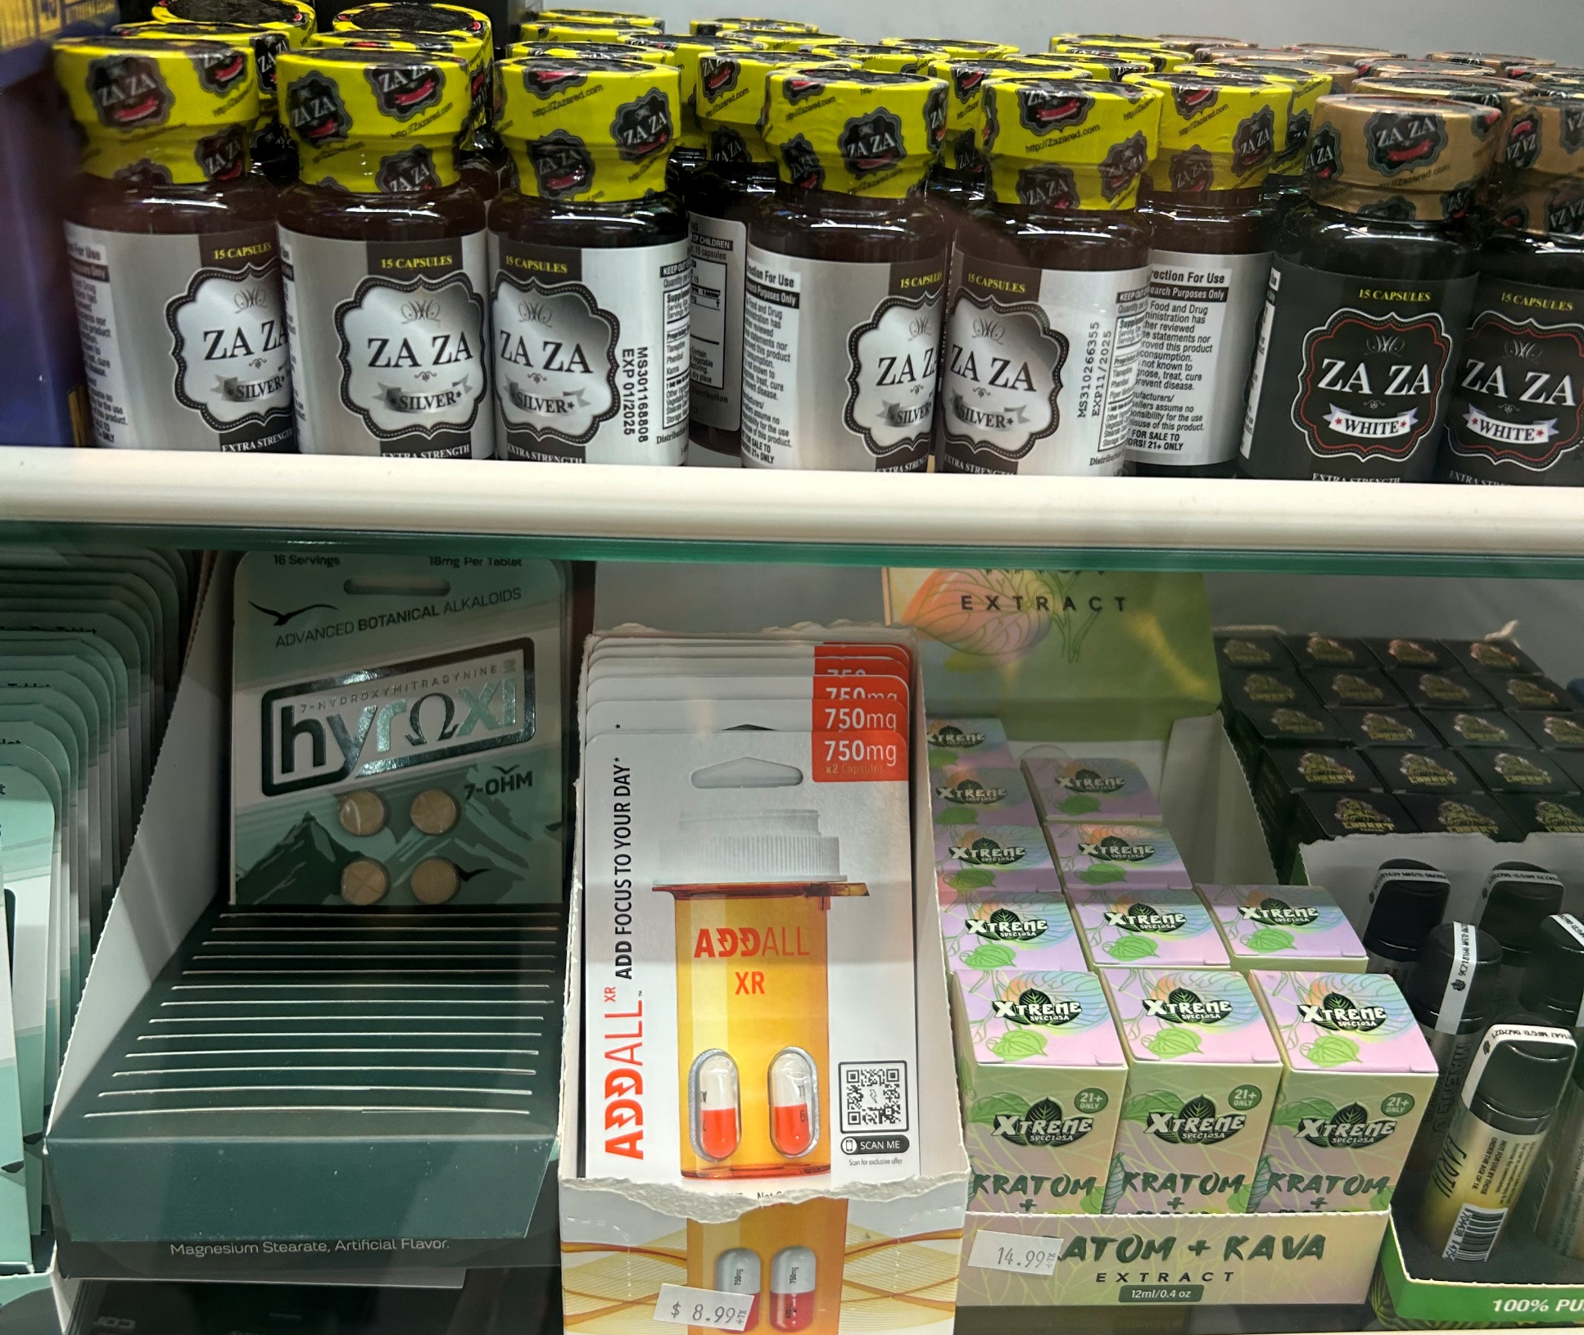
Monitoring Emerging Drug Trends
Cannabis extract products—Delta 9, Delta 8, THC-A (vape & edible)
7-hydroxymitragynine (highly potent kratom extract, powder, tablet, & vape)
Psilocybin & amanita extracts (vape, tincture, & edible)
Phenibut (dietary supplement)
No legal minimum age to purchase
12 shops within city limits

Slide 17
Behavioral Health Indicators—High School
~30% indicate their life has been negatively impacted by substance use
9 poor mental health days per month
About 40% report needing mental health care in the last 12 months
47% report improved mental health
11% did not receive needed mental health care (down from 24% in 2021)
84% report at least 1 healthy coping strategy
85% are able to get the social & emotional support they need
82% have a caring adult in their lives

Slide 18
Recommendations
Data integrity—collect and track other proxy measures
Emerging drug trends—educate teachers & advocate to elected officials
Prevention & intervention—establish multiple pathways for parent engagement to ensure optimum uptake in services

