Slide 1
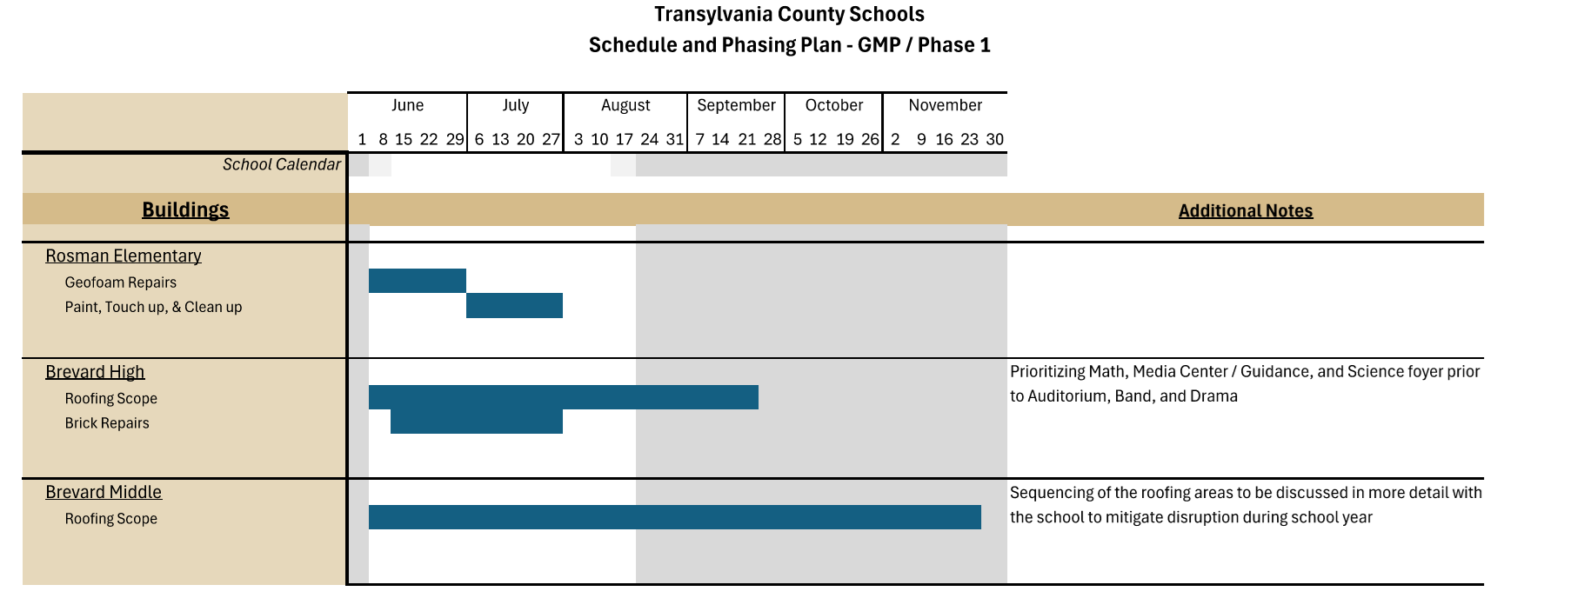
GMP 1 Summer Work start 6/8/2026

Slide 2
GMP 2 remains on schedule
GMP 2 preliminary pricing estimates from the CMAR have been reviewed to date.
As presented in the 2/5/26 subcommittee meeting, the project team will be bringing forward an option for security vestibule improvements beyond the original scope for vestibule improvements that would create a standard safety entry at all schools. Changes in Retaining wall scope approved to be brought into GMP 2 will be reviewed by the subcommittee per the interlocal agreement on 5-29-2026 and proceed to the two governing boards as needed if subcommittee approves in your June Meeting.
Next step for GMP 2 Timeline is Final Construction Documents (minus BHS drawings) by 5/29/2026 with CMAR resulting review end of July. Ready for Owner Review by 8/28/2026. That will finalize detailed construction timeline for the remainder of the scopes.
Current projected completion for all work is by the end of 2028 at this time.

Slide 3
Update from Finance
Education Capital Fund Financial reports through March 31,2026 have been provided to TCS Superintendent and Finance Officer 4/7/26. In addition, Education Capital financials has been included in the County Finance Director’s Quarterly report for all county funds to the Commissioners on April 27, 2026.
All construction pay apps have been paid for the EC Wing project and final reconciliation being done for project close out.
We are still waiting for final invoices on the BHS old gym roof project and will have final project numbers within approximately 30 days of receipt.
BHS Softball Lighting Project closed out.
All School Capital projects are within approved budgets.

