Slide 1
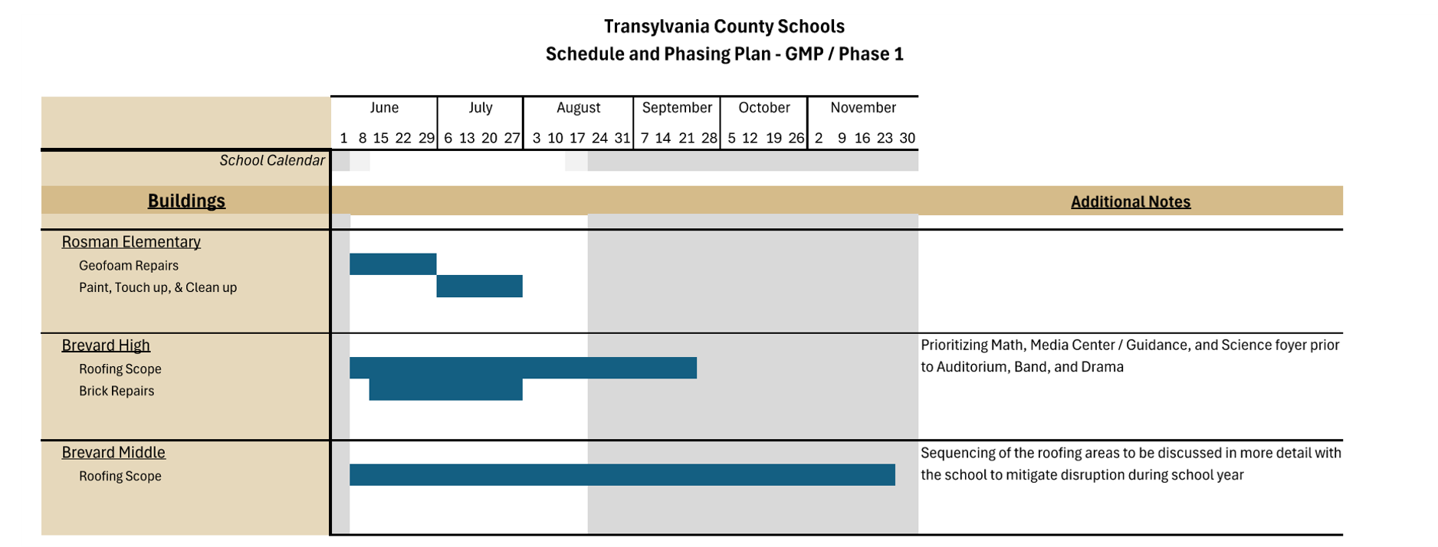
Summer work for GMP 1 began 6/8/2026.
Ongoing coordination about the next phase of work with staff on school sites is on going for Rosman Area Schools. Owner deliverable scheduled for 8/25/2026. Will be able to lock in coordinated efforts with TCS.
Still on schedule and under budget for original scopes of work. RES work complete. BMS and BHS to complete by middle of September for GMP 1 work.
Project Updates

Slide 3
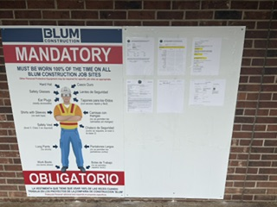
BLUM SITE SAFETY BOARD / PERMIT/INSPECTION INFORMATION AT EACH SITE

Slide 4
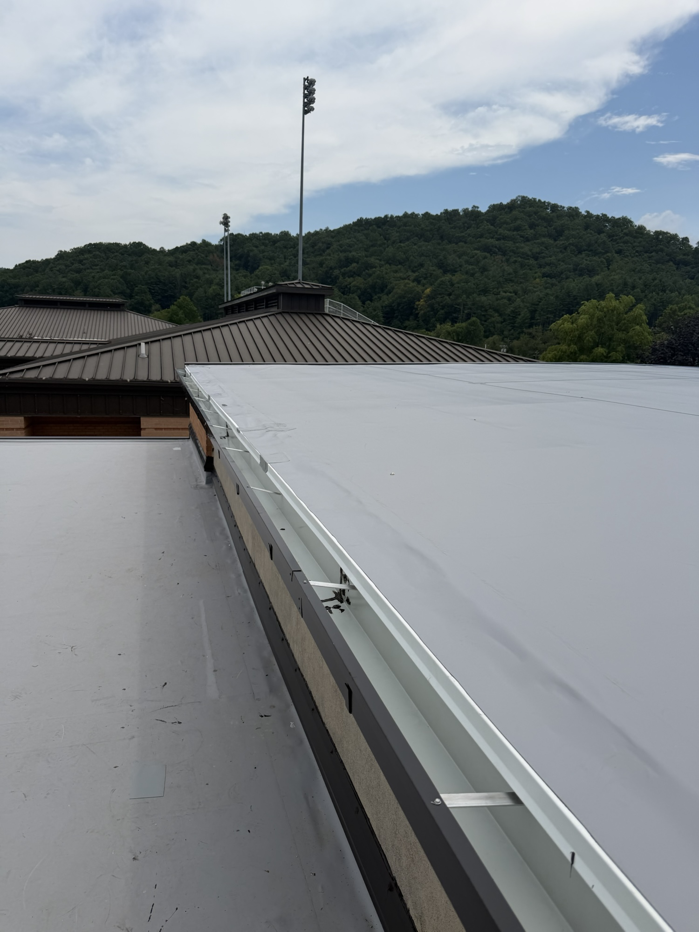
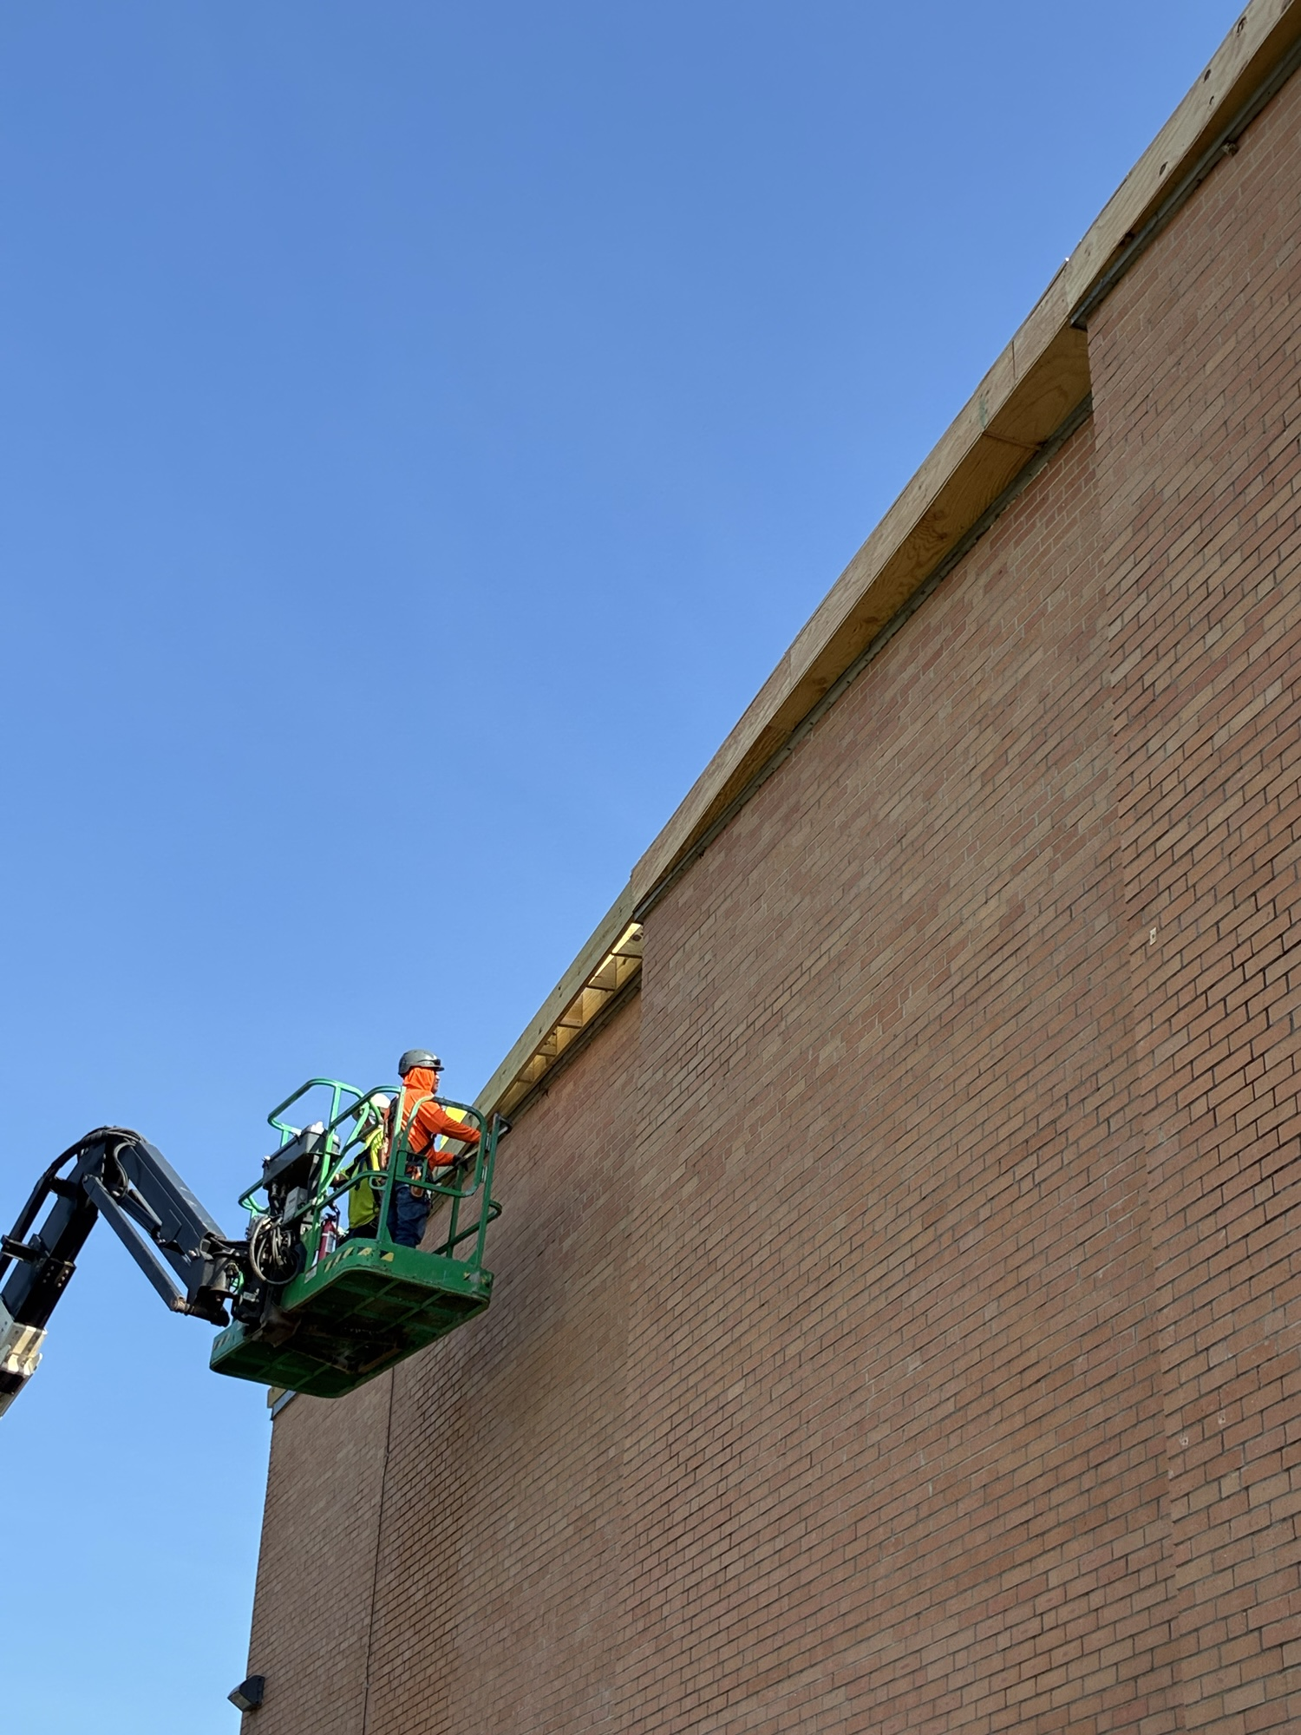
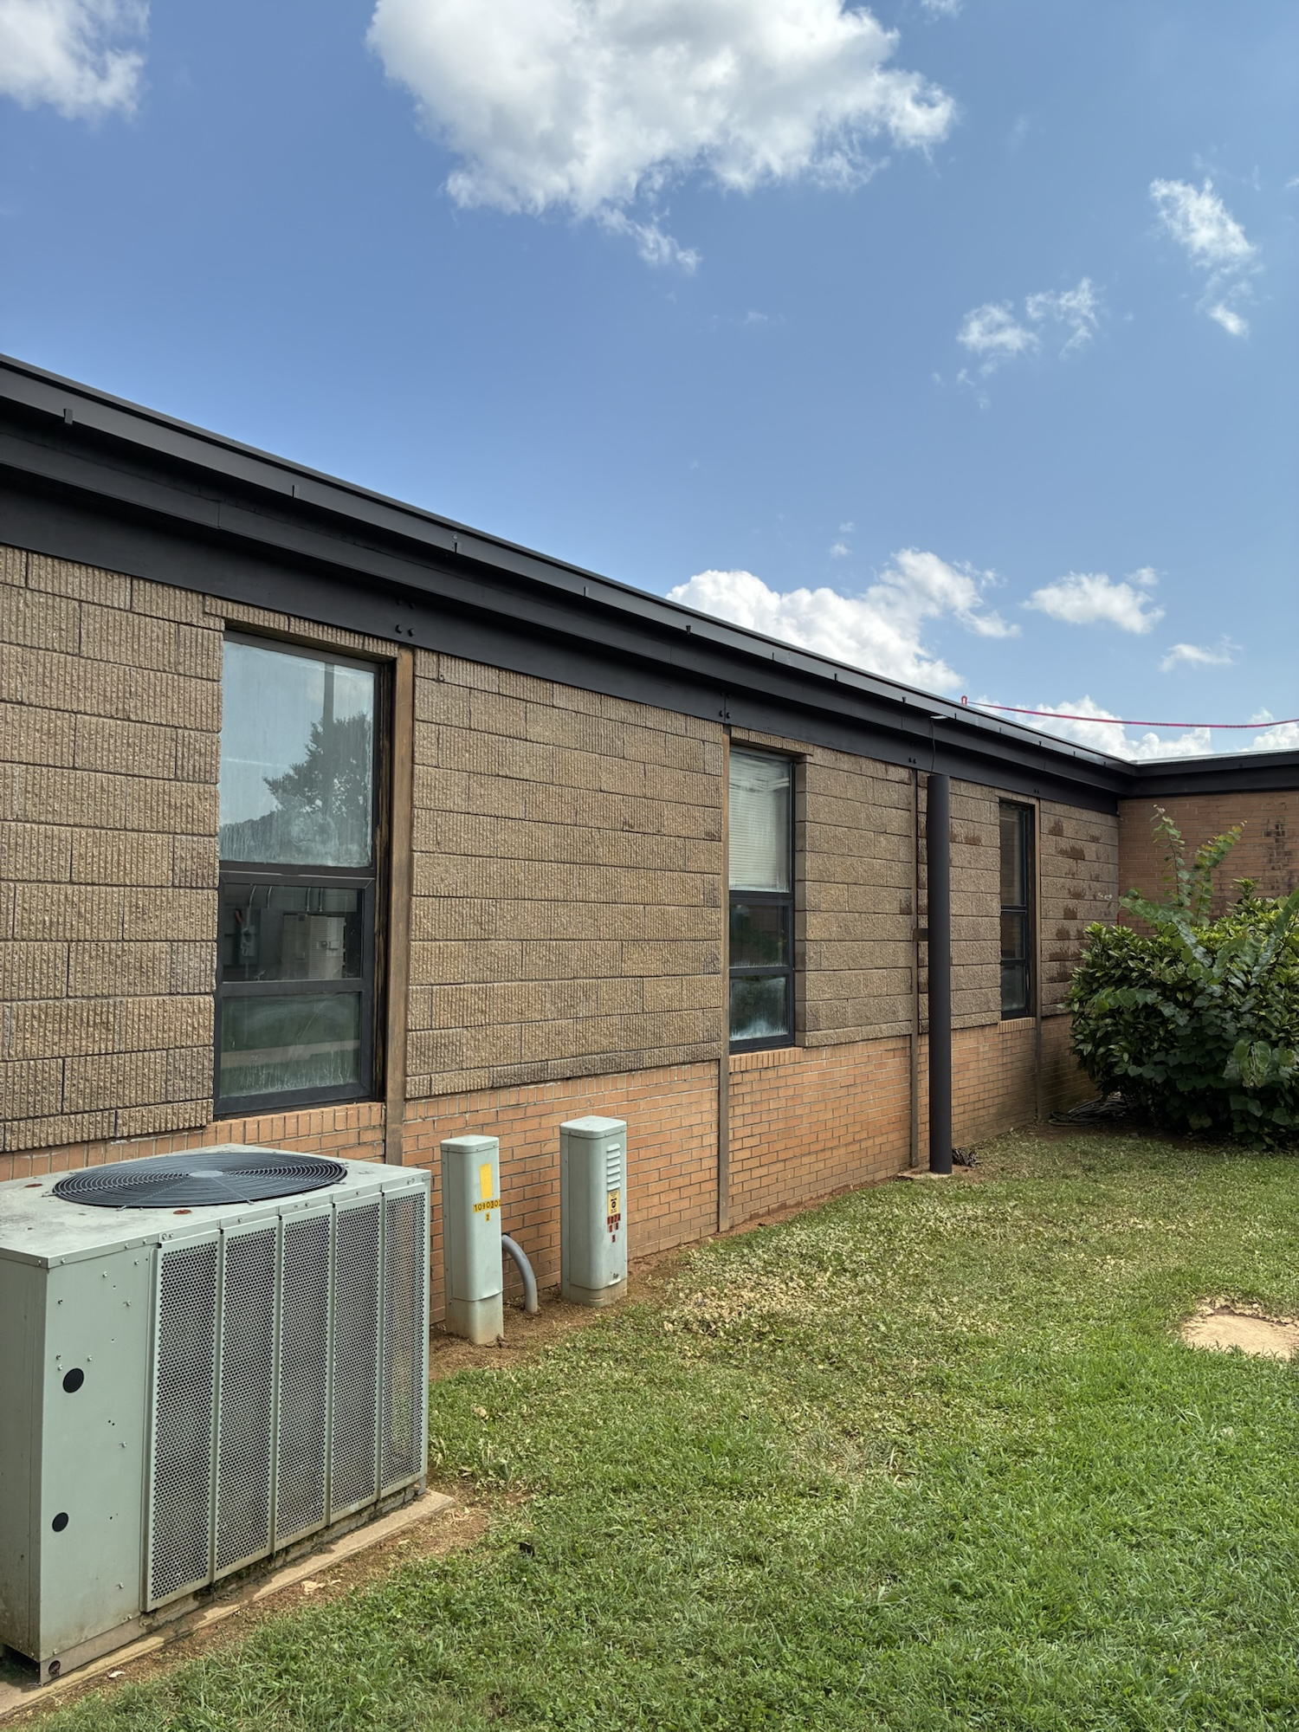
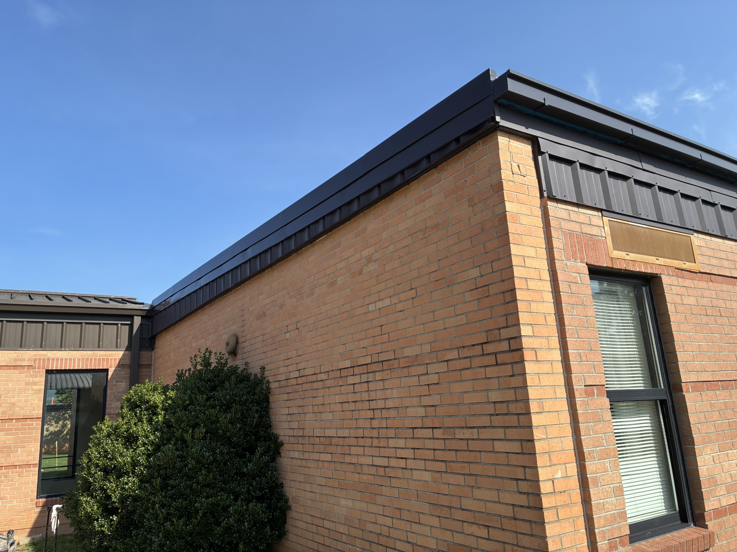
BHS SCHOOL SITE PROGRESS PHOTOS

Slide 5
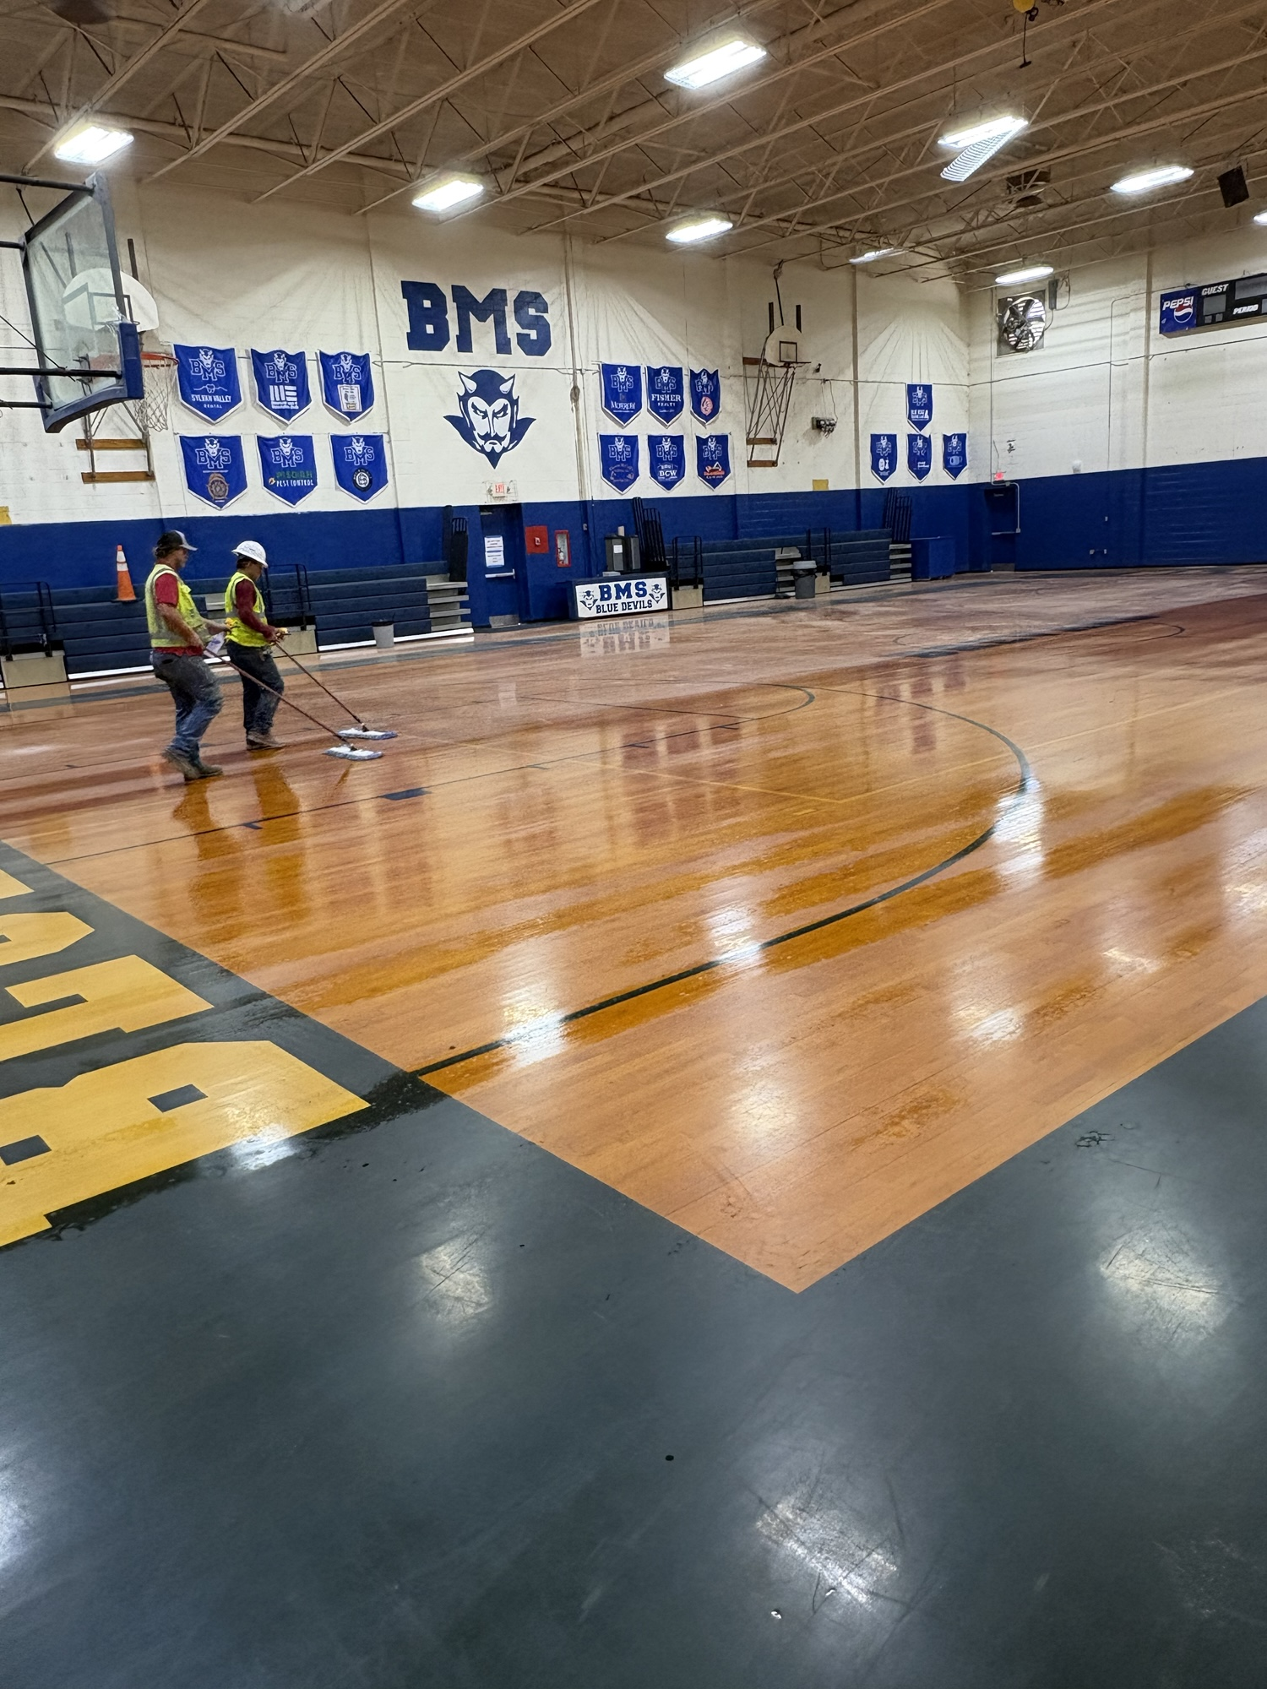
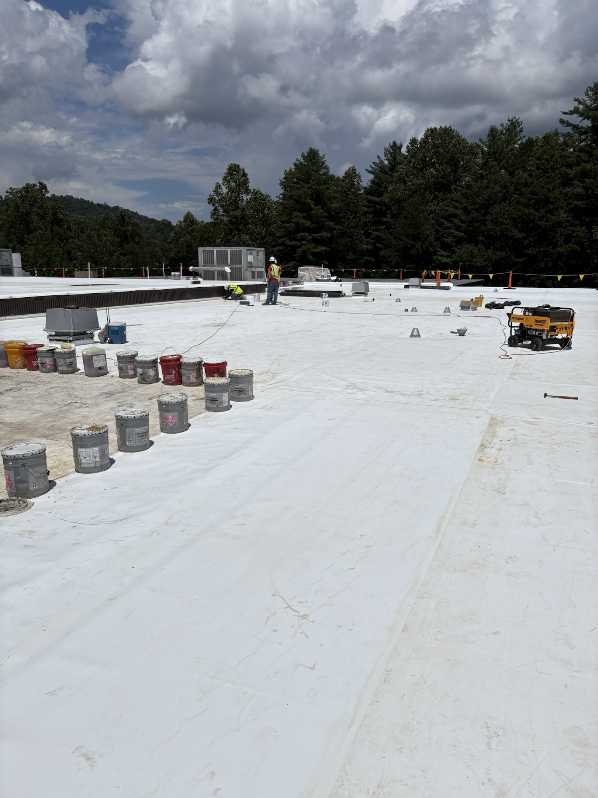
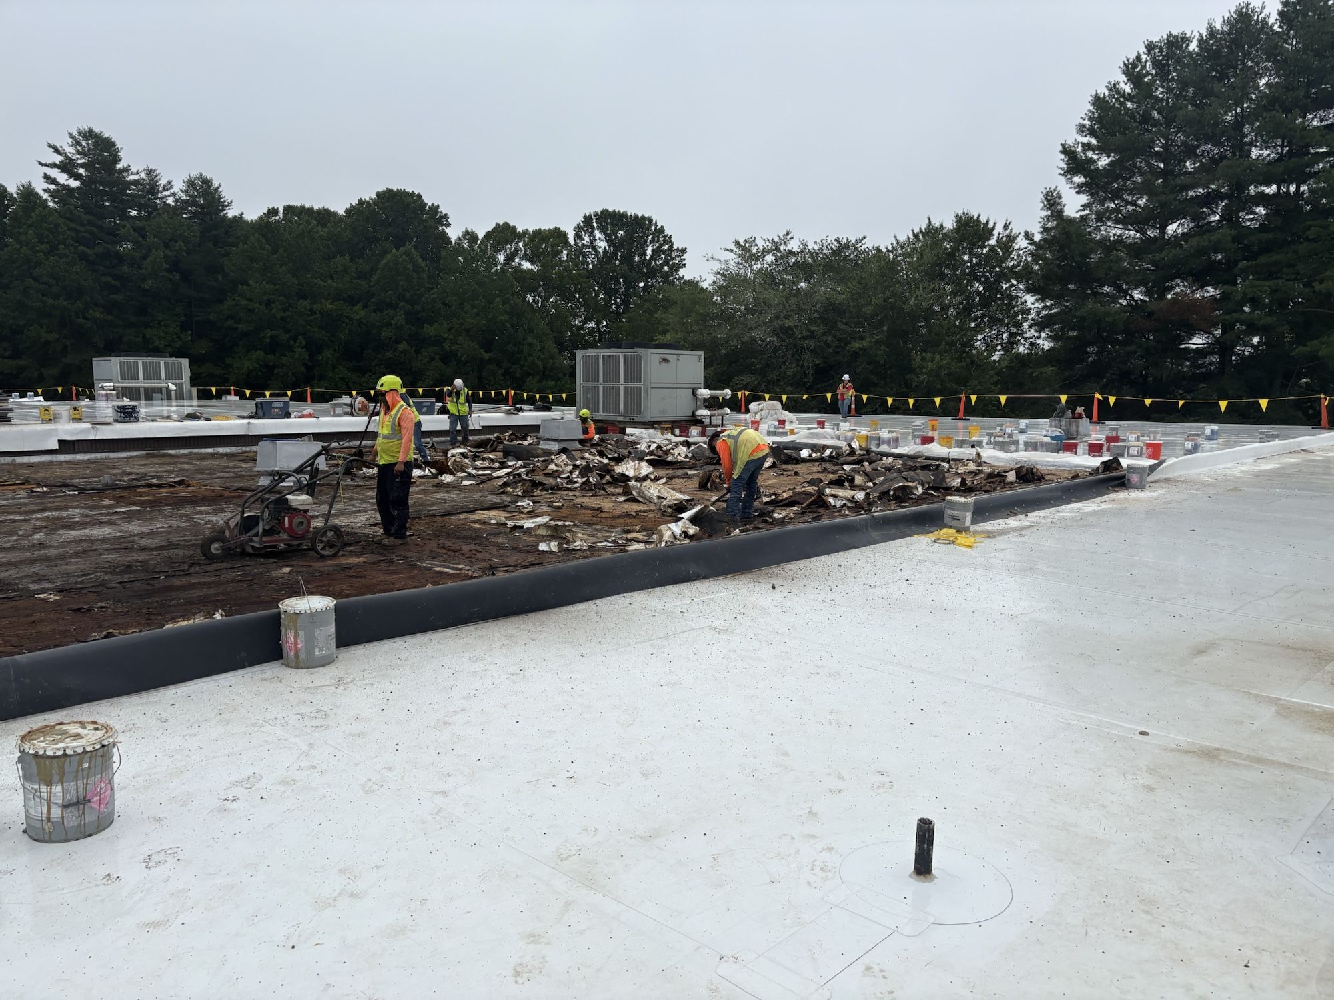
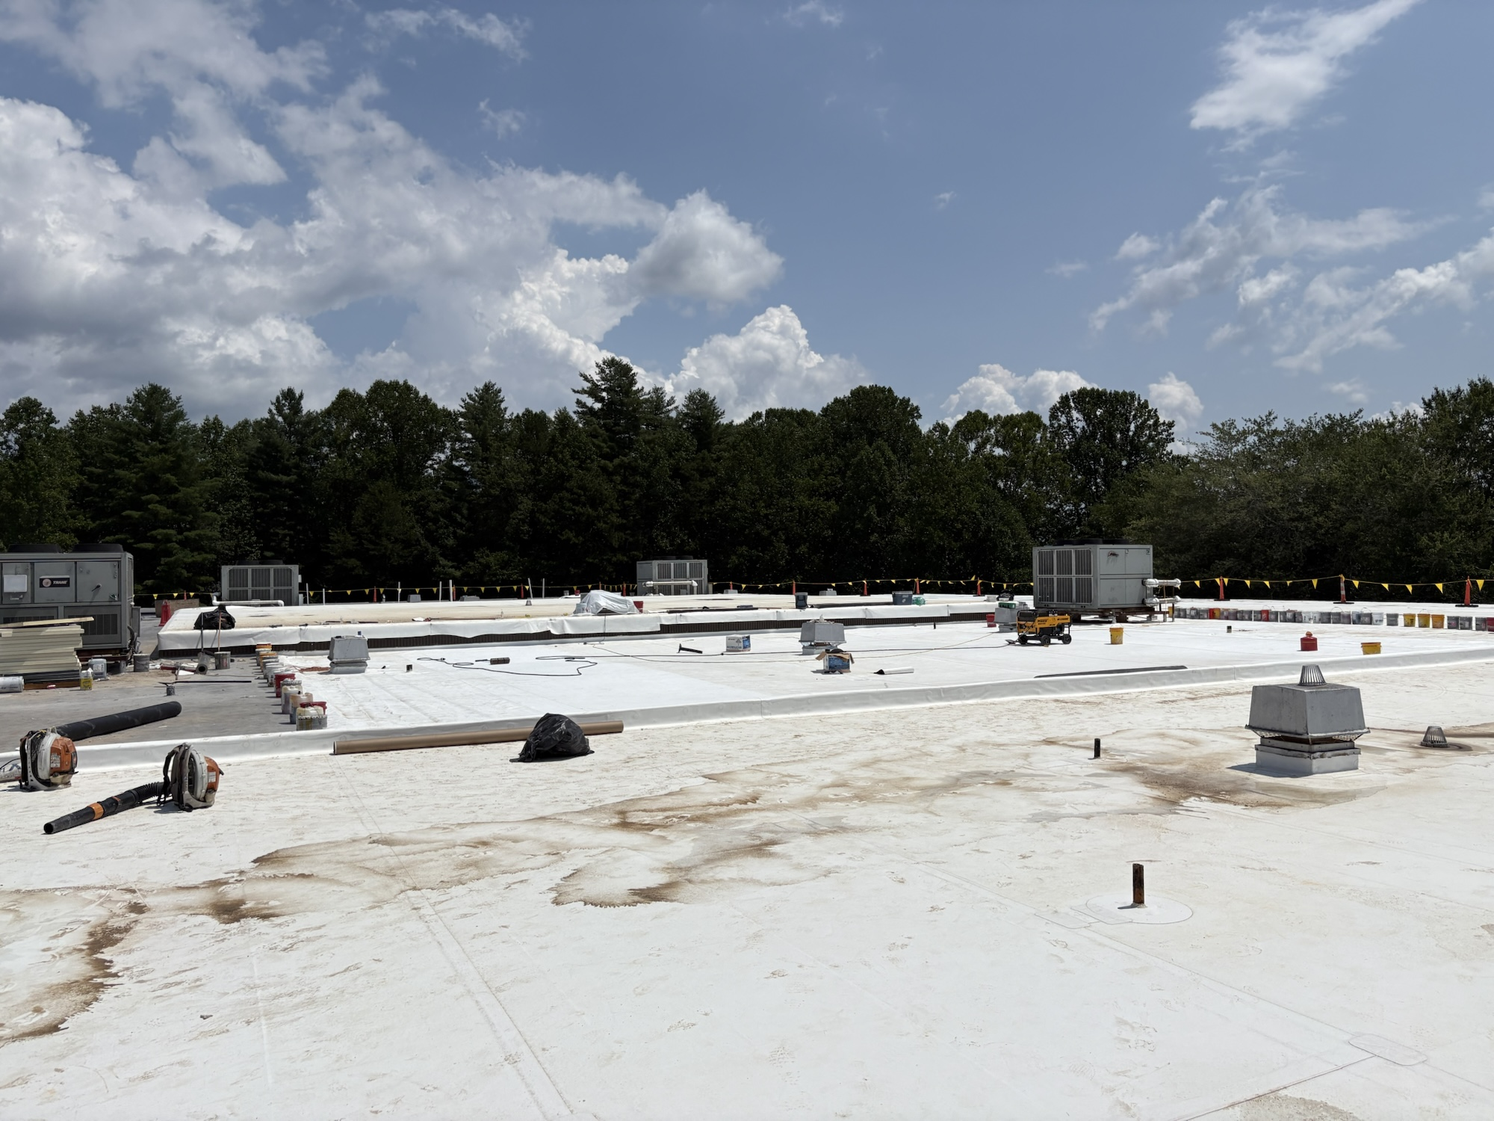
BMS SITE PROGRESS PHOTOS

Slide 6
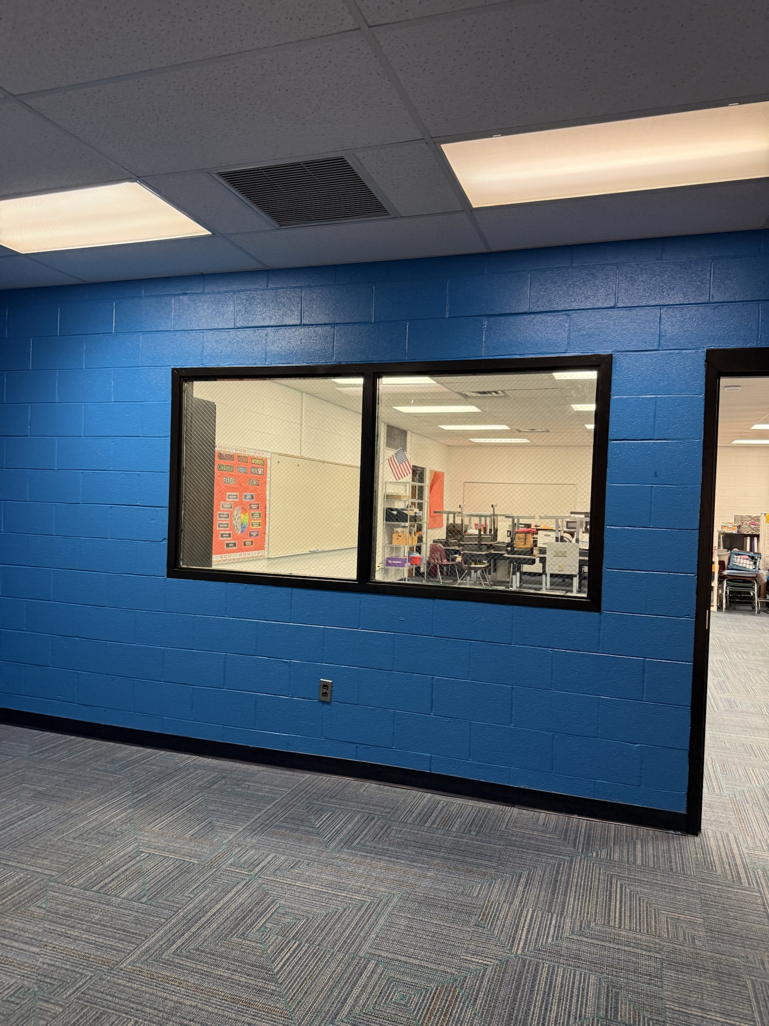
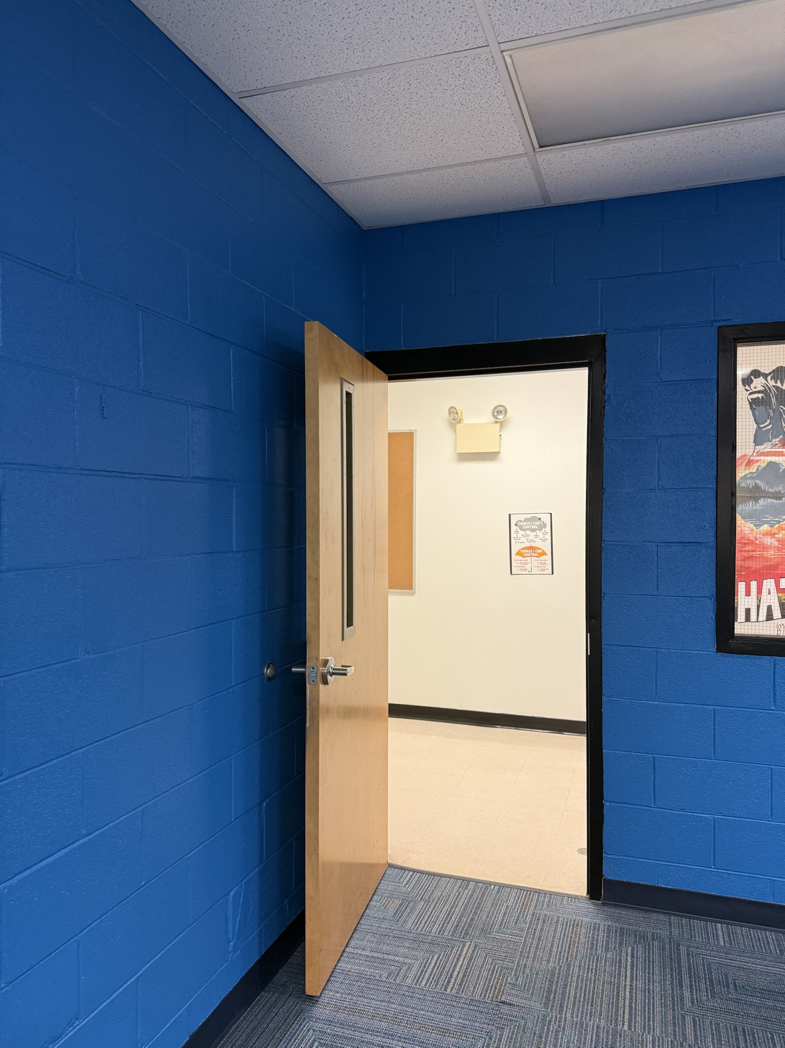
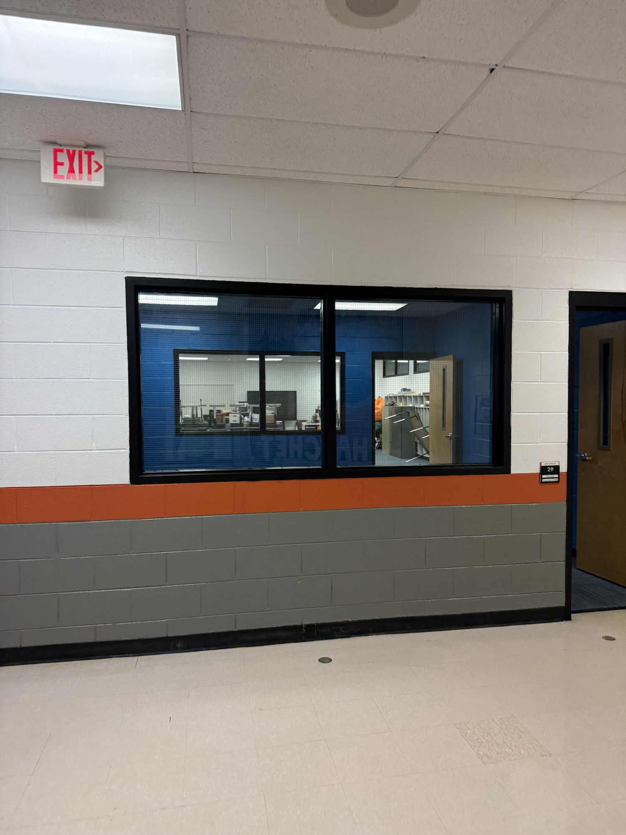
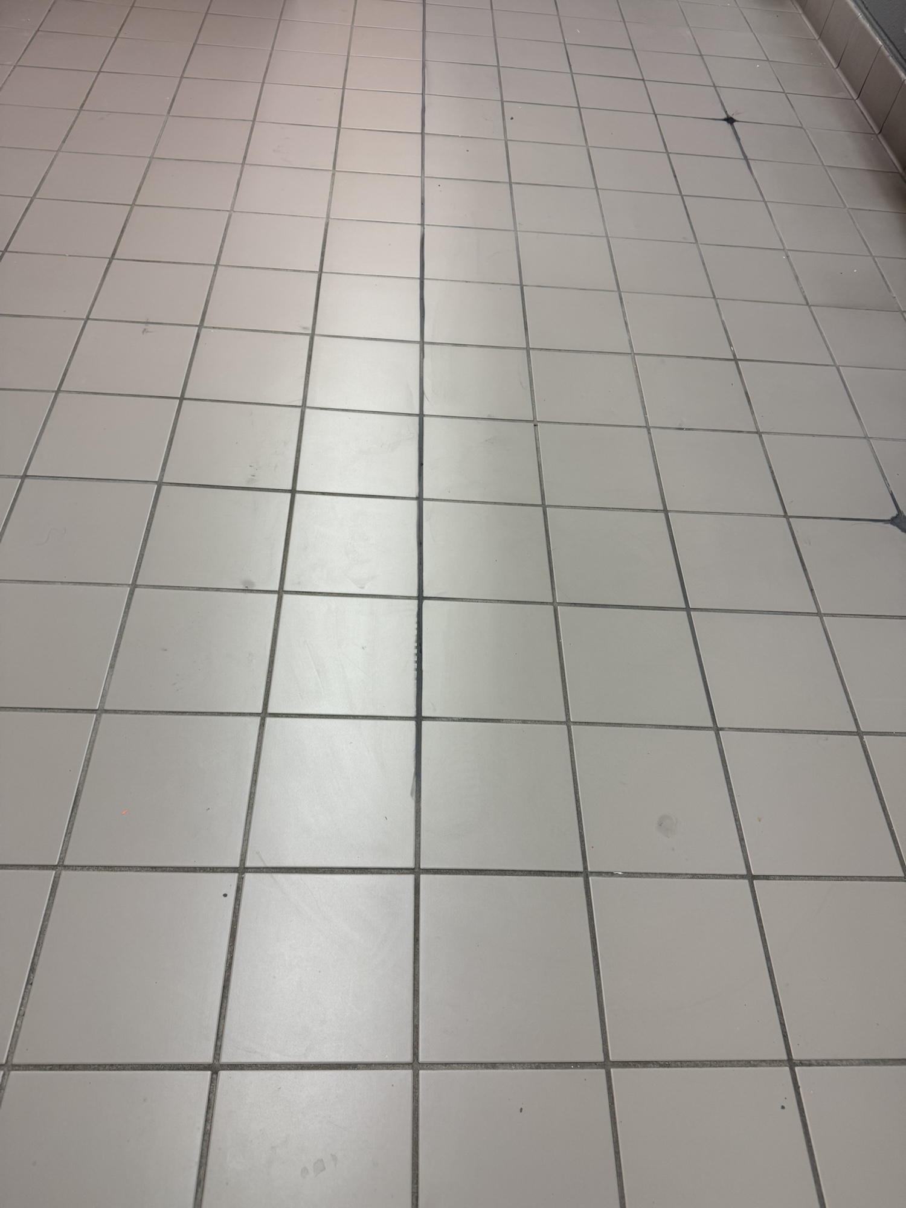
RES SITE PROGRESS PHOTOS

Slide 7
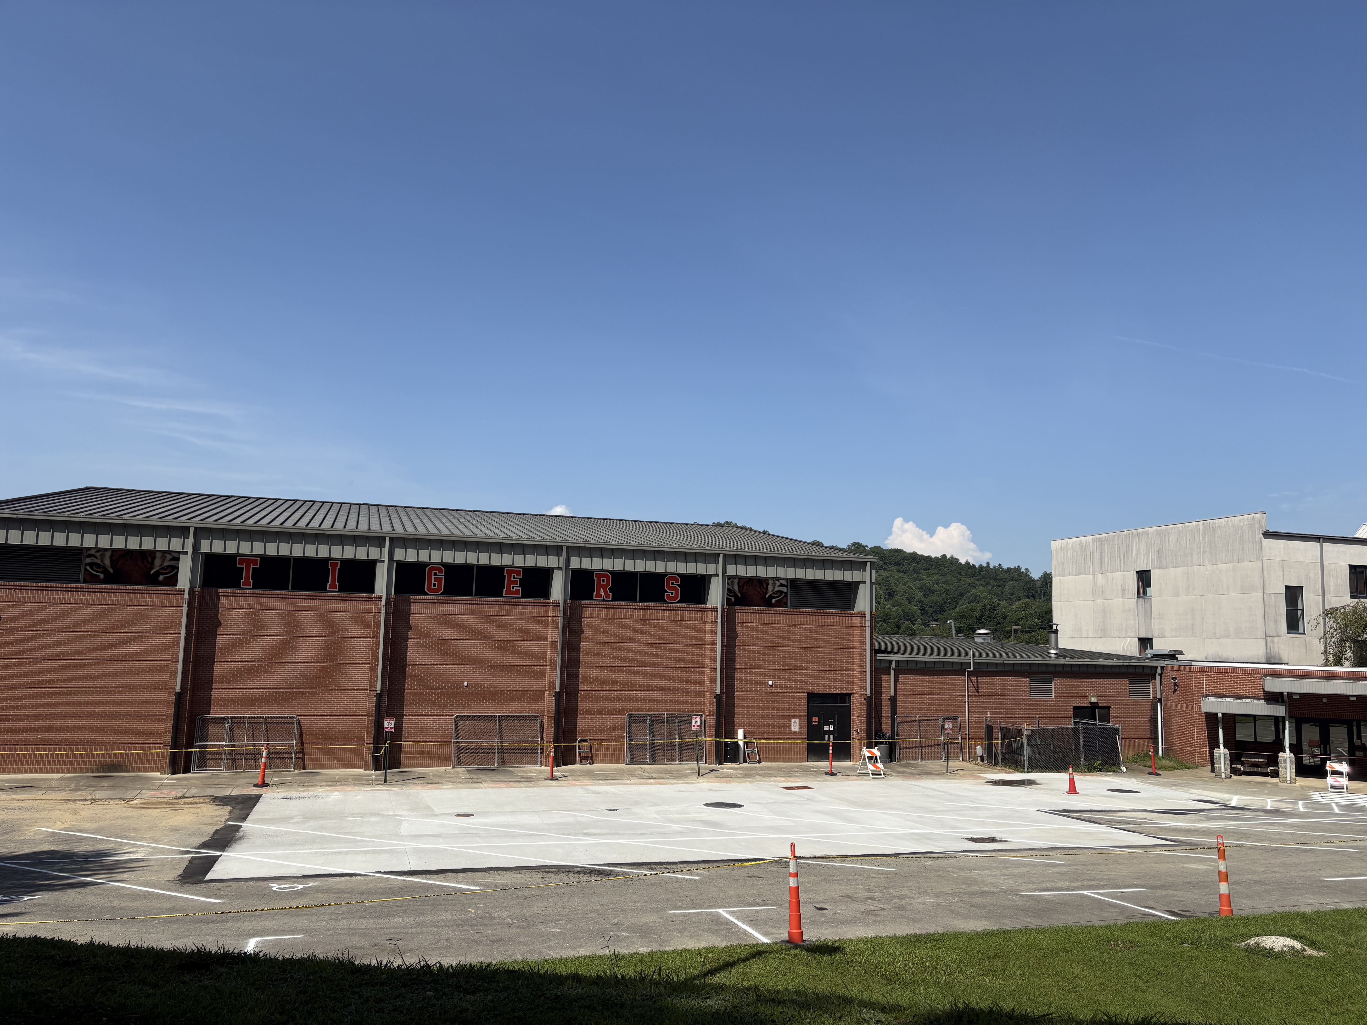
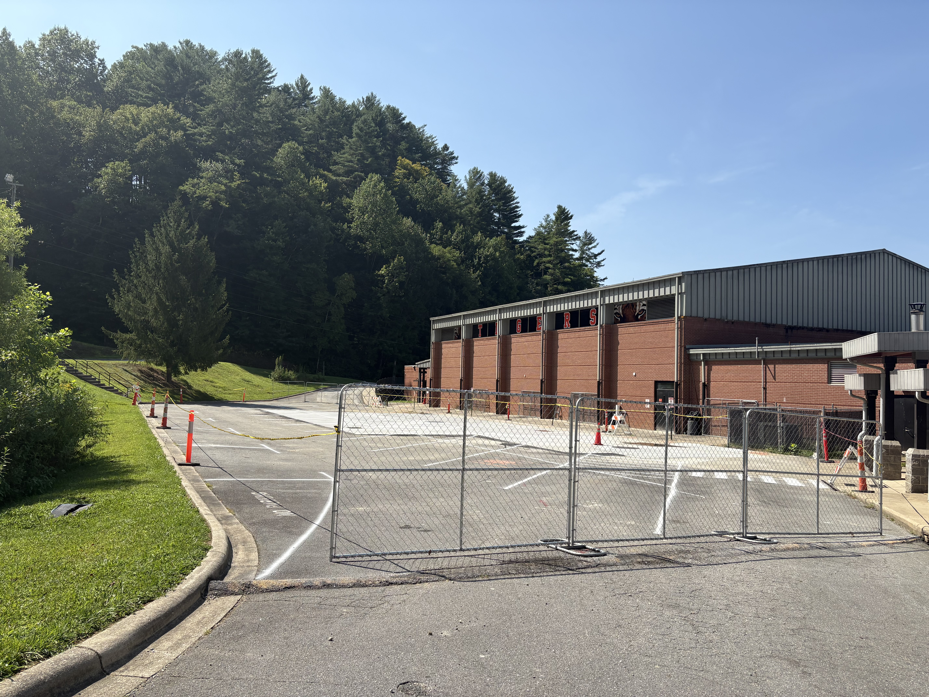
RHS Tank Replacement Progress Photos

Slide 8
